Slide 1
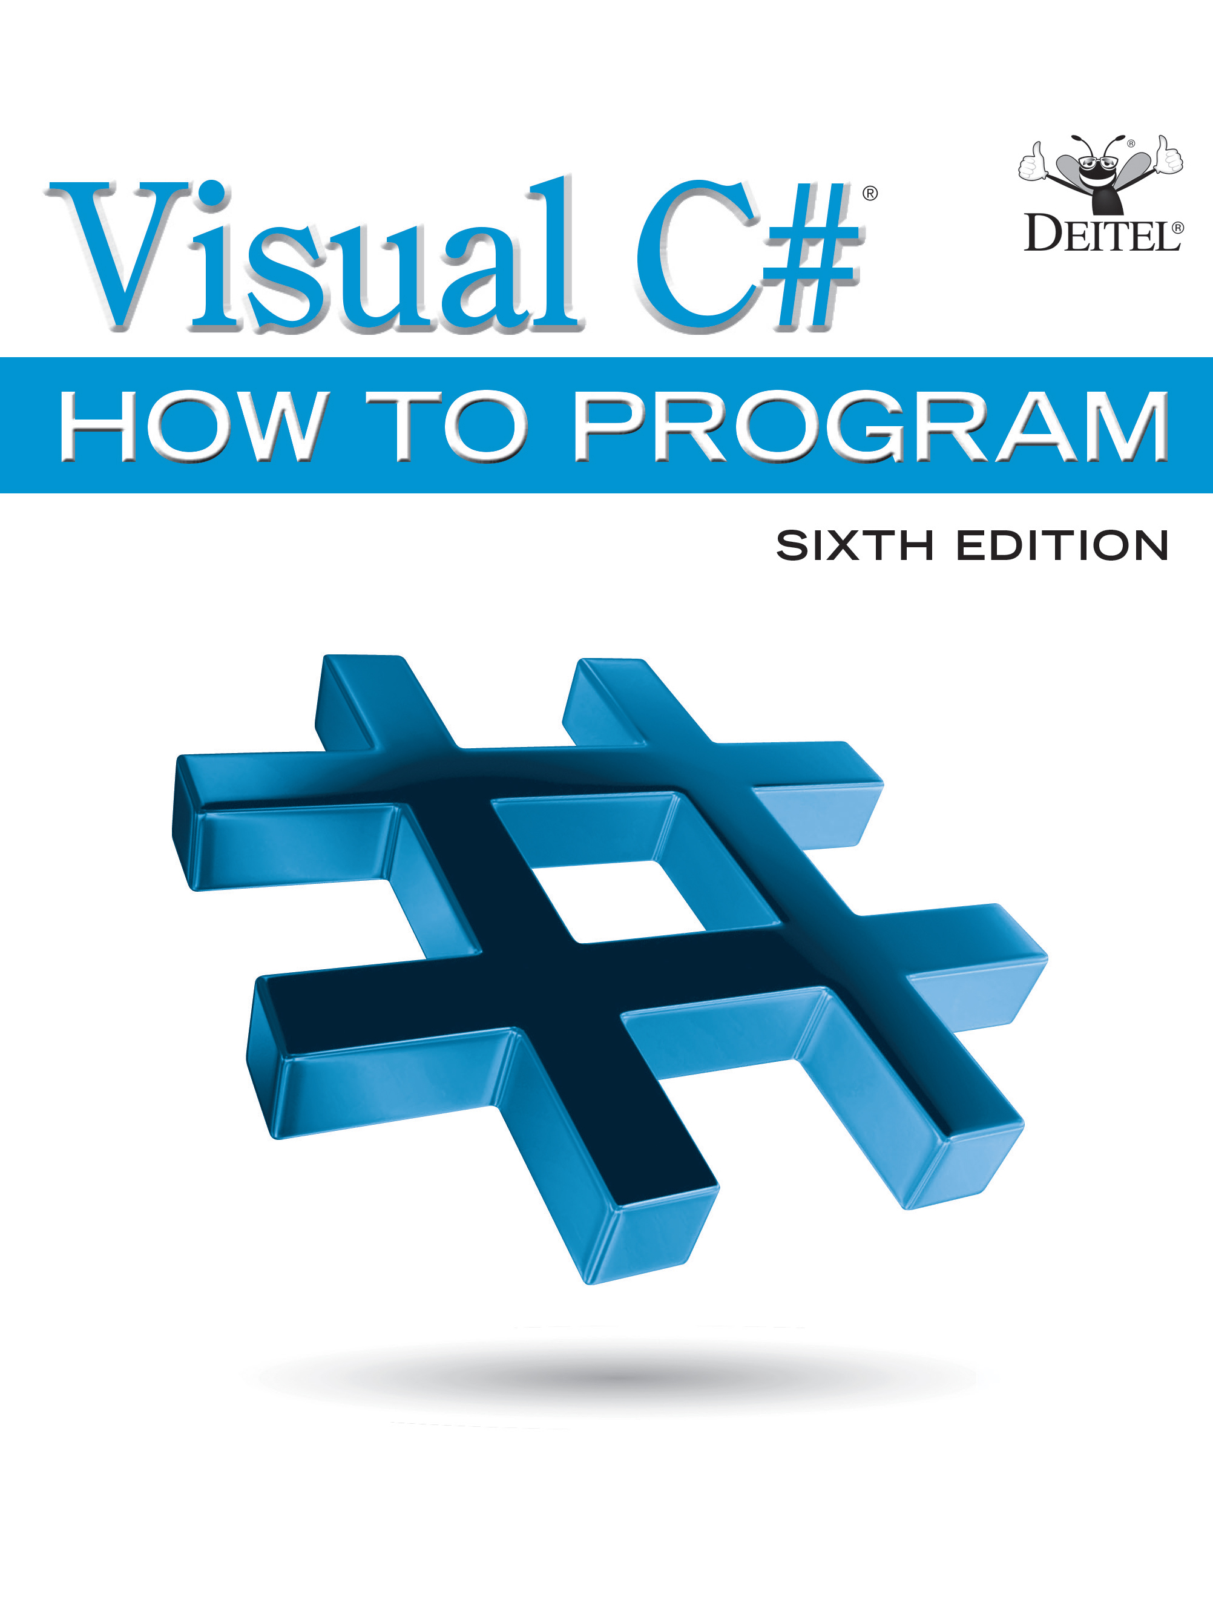
Visual C sharp® How to Program
Sixth Edition
Chapter 21
Generic Collections: Functional Programming with L I N Q/P L I N Q
Copyright © 2017 Pearson Education, Inc. All Rights Reserved
Notes:
If this PowerPoint presentation contains mathematical equations, you may need to check that your computer has the following installed:
1) MathType Plugin
2) Math Player (free versions available)
3) NVDA Reader (free versions available)

Slide 2
Learning Objectives (1 of 2)
Learn about additional .NET generic collections.
Manipulate arrays with class Array’s static methods.
Provide a using static directive to access a class’s static members without fully qualifying their names.
Iterate through a collection with enumerators.
Use generic collections Sorted Dictionary and Linked List.
Use the
6 null-conditional ?[ ] operator to access array or collection elements.

Slide 3
Learning Objectives (2 of 2)
Use
6 index initializers to initialize a dictionary.
Store method references in delegate variables, then use those variables to invoke the corresponding methods.
Use lambda expressions to create anonymous methods and refer to those methods via delegate variables.
Use L I N Q method-call syntax and lambdas to demonstrate functional programming techniques.
Parallelize L I N Q operations with P L I N Q for multicore performance.
Learn covariance and contravariance for generic types.

Slide 4
Outline (1 of 5)
21.1 Introduction
21.2 Collections Overview
21.3 Class Array and Enumerators
21.3.1
6 using static Directive
21.3.2 Class Using Array’s static Fields
21.3.3 Array Method Sort
21.3.4 Array Method Copy
21.3.5 Array Method BinarySearch
21.3.6 Array Method GetEnumerator and Interface IEnumerator

Slide 5
Outline (2 of 5)
21.3.7 Iterating Over a Collection with foreach
21.3.8 Array Methods Clear, IndexOf, LastIndexOf and Reverse
21.4 Dictionary Collections
21.4.1 Dictionary Fundamentals
21.4.2 Using the SortedDictionary Collection
21.5 Generic LinkedList Collection
21.6
6 Null Conditional Operator ?[ ]
21.7
6 Dictionary Initializers and Collection Initializers

Slide 6
Outline (3 of 5)
21.8 Delegates
21.8.1 Declaring a Delegate Type
21.8.2 Declaring a Delegate Variable
21.8.3 Delegate Parameters
21.8.4 Passing a Method Name Directly to a Delegate Parameter
21.9 Lambda Expressions
21.9.1 Expression Lambdas
21.9.2 Assigning Lambdas to Delegate Variables
21.9.3 Explicitly Typed Lambda Parameters
21.9.4 Statement Lambdas

Slide 7
Outline (4 of 5)
21.10 Introduction to Functional Programming
21.11 Functional Programming with L I N Q Method-Call Syntax and Lambdas
21.11.1 L I N Q Extension Methods Min, Max, Sum and Average
21.11.2 Aggregate Extension Method for Reduction Operations
21.11.3 The Where Extension Method for Filtering Operations
21.11.4 Select Extension Method for Mapping Operations

Slide 8
Outline (5 of 5)
21.12 P L I N Q: Improving L I N Q to Objects Performance with Multicore
21.13 (Optional) Covariance and Contravariance for Generic Types
21.14 Wrap-Up

Slide 9
Figure 21.1 Some Common Generic Collection Interfaces (1 of 2)
Interface | Description
IEnumerable<T> | An object that can be enumerated—for example, a foreach loop can iterate over such an object’s elements. This interface contains one method, GetEnumerator, which returns an IEnumerator<T> object, which (as you’ll see in Section 21.3) can be used manually to iterate through a collection. In fact, foreach uses a collection’s IEnumerator<T> object behind the scenes. ICollection<T> extends IEnumerable<T> so all collection classes implement IEnumerable directly or indirectly.
ICollection<T> | The interface from which interfaces IList<T> and IDictionary<K,V> inherit. Contains a Count property to determine the size of a collection and a CopyTo method for copying a collection’s contents to a traditional array, and an IsReadOnly property.

Slide 10
Figure 21.1 Some Common Generic Collection Interfaces (2 of 2)
Interface | Description
IList<T> | An ordered collection that can be manipulated like an array. Provides a [ ] operator (known as an indexer) for accessing elements with an int index. Also has methods for searching and modifying a collection, including Add, Remove, Contains and IndexOf.
IDictionary<K,V> | A collection of values, indexed by an arbitrary “key” object of type K. Provides an indexer ([ ]) for accessing elements by key and methods for modifying the collection (e.g., Add, Remove). IDictionary<K,V> property Keys contains all the keys, and property Values contains all the stored values.

Slide 11
Figure 21.2 Some .NET Framework Collection Classes (1 of 4)
System namespace
Class | Implements interface | Description
Array | IList | The base class of all conventional arrays. See Section 21.3.
System.Collections.Generic namespace
Class | Implements interface | Description
Dictionary<K, V> | IDictionary<K, V> | A generic, unordered collection of key–value pairs that can be accessed rapidly by key. See Section 17.9.2.
LinkedList<T> | ICollection<T> | A generic doubly linked list. See Section 21.5.

Slide 12
Figure 21.2 Some .NET Framework Collection Classes (2 of 4)
Class | Implements interface | Description
List<T> | IList<T> | A generic array-based list. See Section 9.4.
Queue<T> | ICollection<T> | A generic first-in, first-out (F I F O) collection. See Section 19.6 for information on queues.
SortedDictionary<K, V> | IDictionary<K, V> | A Dictionary that sorts the data by the keys in a binary tree. See Section 21.4.
SortedList<K, V> | IDictionary<K, V> | Similar to a SortedDictionary, but uses arrays internally. If the data already exists and is sorted before insertion in a collection, then inserting in a SortedList is faster than a SortedDictionary. If the data is not sorted, insertion in a SortedDictionary is faster.

Slide 13
Figure 21.2 Some .NET Framework Collection Classes (3 of 4)
Class | Implements interface | Description
Stack<T> | ICollection<T> | A generic last-in, first-out (L I F O) collection. See Section 19.5 for information on stacks.
Legacy collections of the System.Collections namespace
Class | Implements interface | Description
ArrayList | IList | Mimics conventional arrays, but will grow or shrink as needed to accommodate the number of elements.
BitArray | ICollection | A memory-efficient array of bits in which each bit’s 0 or 1 value represents the bool value false or true. Exercise 21.14 asks you to use a BitArray to implement the Sieve of Eratosthenes algorithm for finding prime numbers.

Slide 14
Figure 21.2 Some .NET Framework Collection Classes (4 of 4)
Class | Implements interface | Description
Hashtable | IDictionary | An unordered collection of key–value pairs that can be accessed rapidly by key.
Queue | ICollection | A first-in, first-out (F I F O) collection. See Section 19.6 for information on queues.
SortedList | IDictionary | A collection of key–value pairs that are sorted by key and can be accessed either by key or by index.
Stack | ICollection | A last-in, first-out (L I F O) collection. See Section 19.5 for information on stacks.

Slide 15
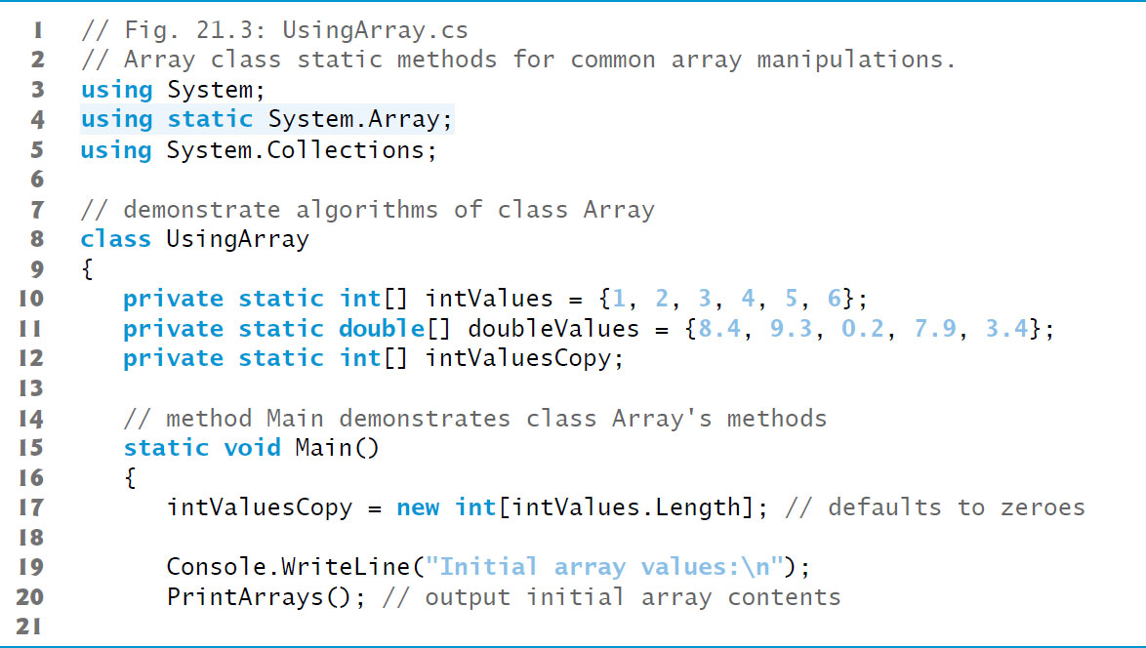
Figure 21.3 Array Class static Methods for Common Array Manipulations (1 of 5)

Slide 16
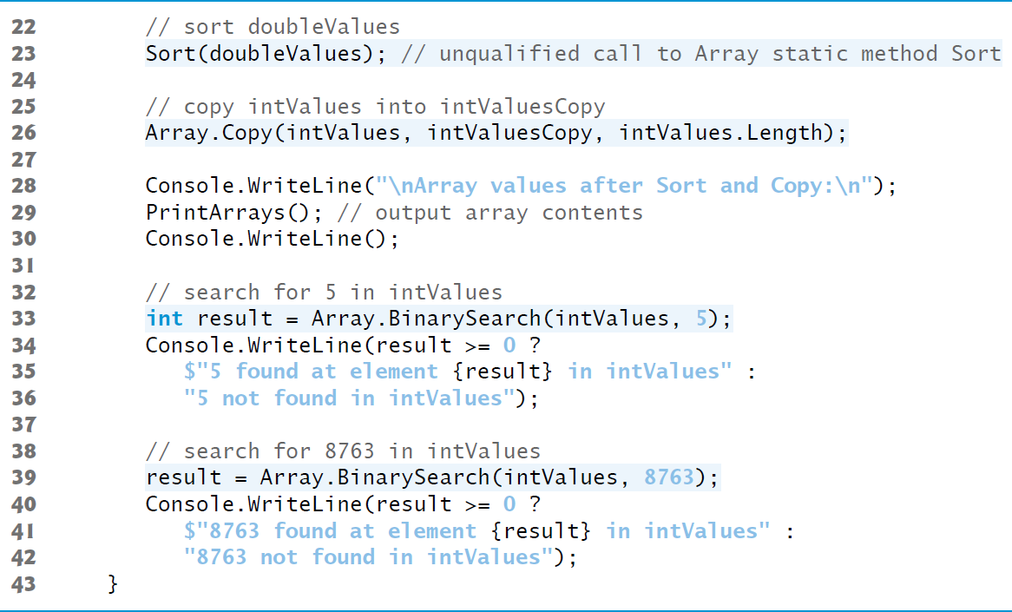
Figure 21.3 Array Class static Methods for Common Array Manipulations (2 of 5)

Slide 17
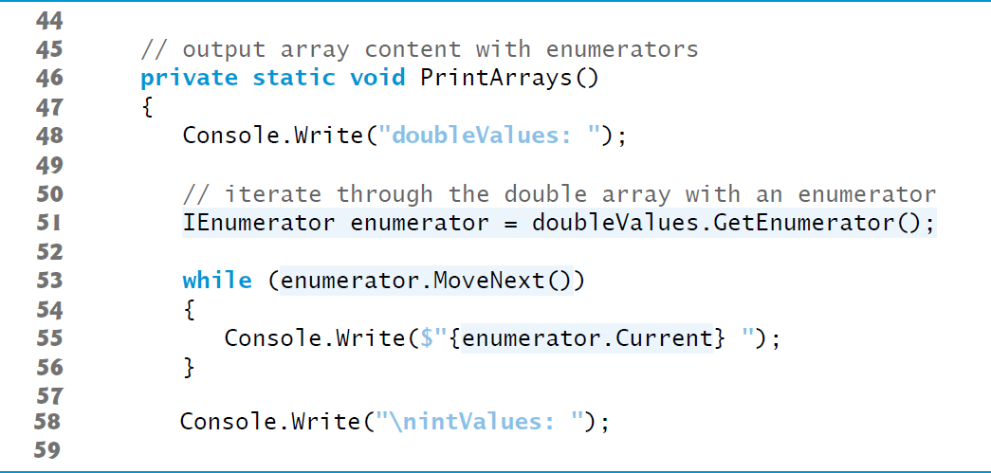
Figure 21.3 Array Class static Methods for Common Array Manipulations (3 of 5)

Slide 18
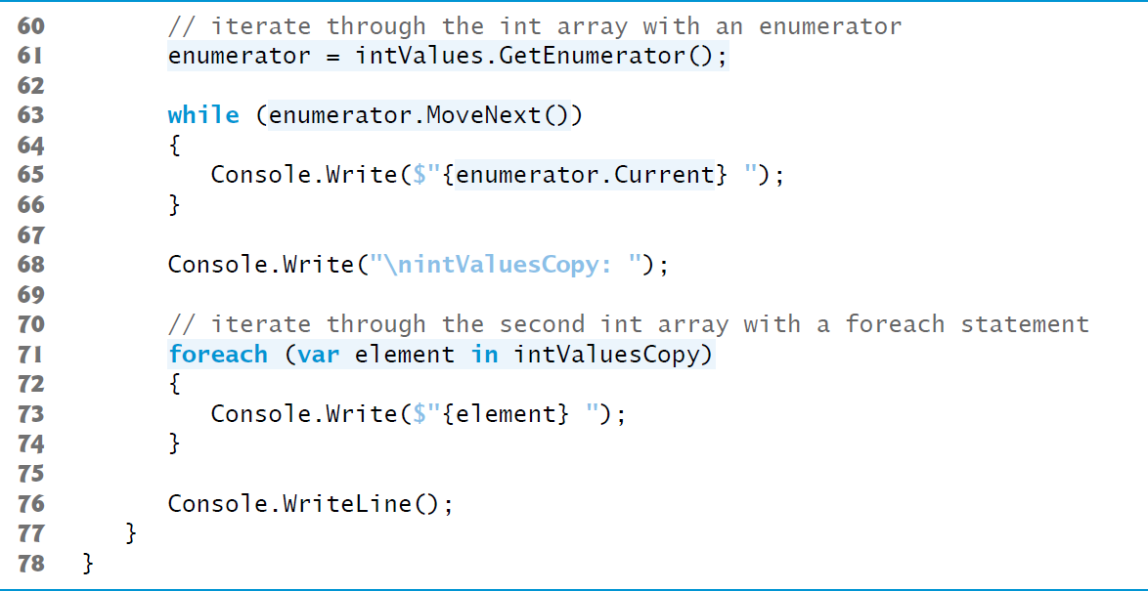
Figure 21.3 Array Class static Methods for Common Array Manipulations (4 of 5)

Slide 19
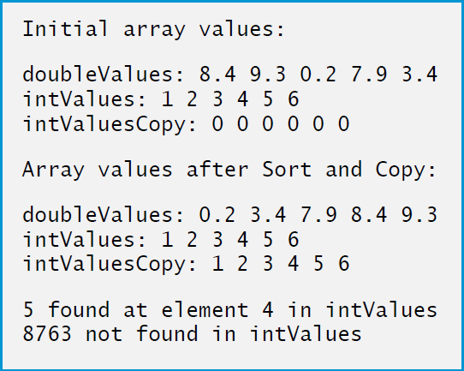
Figure 21.3 Array Class static Methods for Common Array Manipulations (5 of 5)

Slide 20
Common Programming Error 21.1
If a collection is modified after an enumerator is created for that collection, the enumerator immediately becomes invalid—for this reason, enumerators are said to be “fail fast.” Any calls to the enumerator’s Reset or MoveNext methods after this point throw Invalid-Operation Exceptions. This is true for collections, but not for arrays.

Slide 21
Performance Tip 21.1
The load factor in a hash table is a classic example of a space/time trade-off: By increasing the load factor, we get better memory utilization, but the app runs slower due to increased hashing collisions. By decreasing the load factor, we get better speed because of reduced hashing collisions, but we get poorer memory utilization because a larger portion of the hash table remains empty.

Slide 22
Performance Tip 21.2
Because class SortedDictionary keeps its elements sorted in a binary tree, obtaining or inserting a key–value pair takes O(log n) time, which is fast compared to linear searching, then inserting.

Slide 23
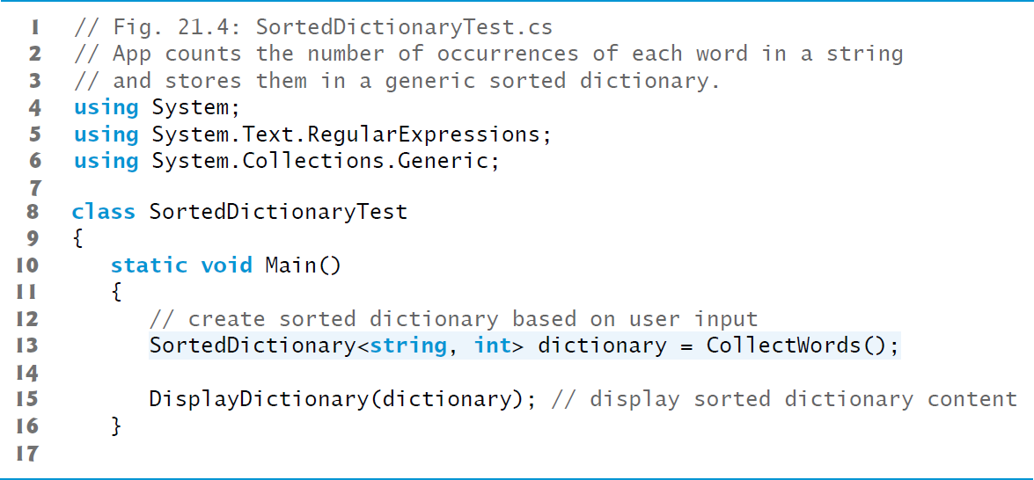
Figure 21.4 App Counts the Number of Occurrences of Each Word in a string and Stores Them in a Generic Sorted Dictionary (1 of 5)

Slide 24
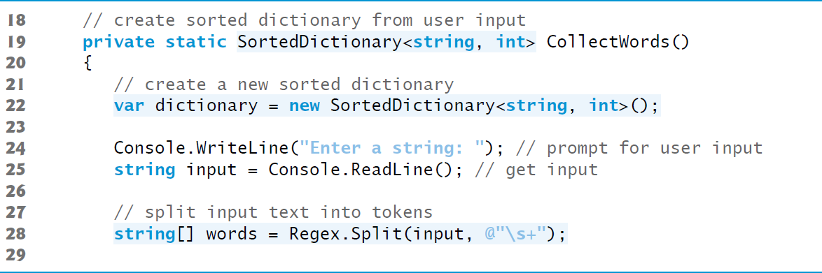
Figure 21.4 App Counts the Number of Occurrences of Each Word in a string and Stores Them in a Generic Sorted Dictionary (2 of 5)

Slide 25
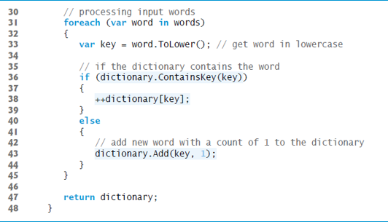
Figure 21.4 App Counts the Number of Occurrences of Each Word in a string and Stores Them in a Generic Sorted Dictionary (3 of 5)

Slide 26
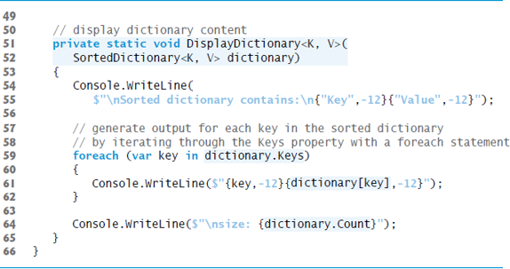
Figure 21.4 App Counts the Number of Occurrences of Each Word in a string and Stores Them in a Generic Sorted Dictionary (4 of 5)

Slide 27
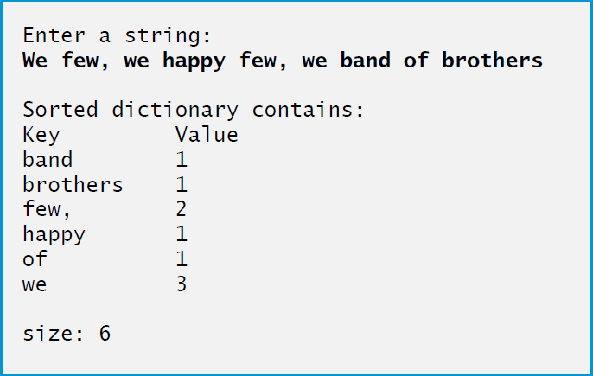
Figure 21.4 App Counts the Number of Occurrences of Each Word in a string and Stores Them in a Generic Sorted Dictionary (5 of 5)

Slide 28
Common Programming Error 21.2
Using the Add method to add a key that already exists in the hash table causes an ArgumentException.

Slide 29
Common Programming Error 21.3
Invoking the get accessor of a SortedDictionary indexer with a key that does not exist in the collection causes a KeyNotFoundException.

Slide 30
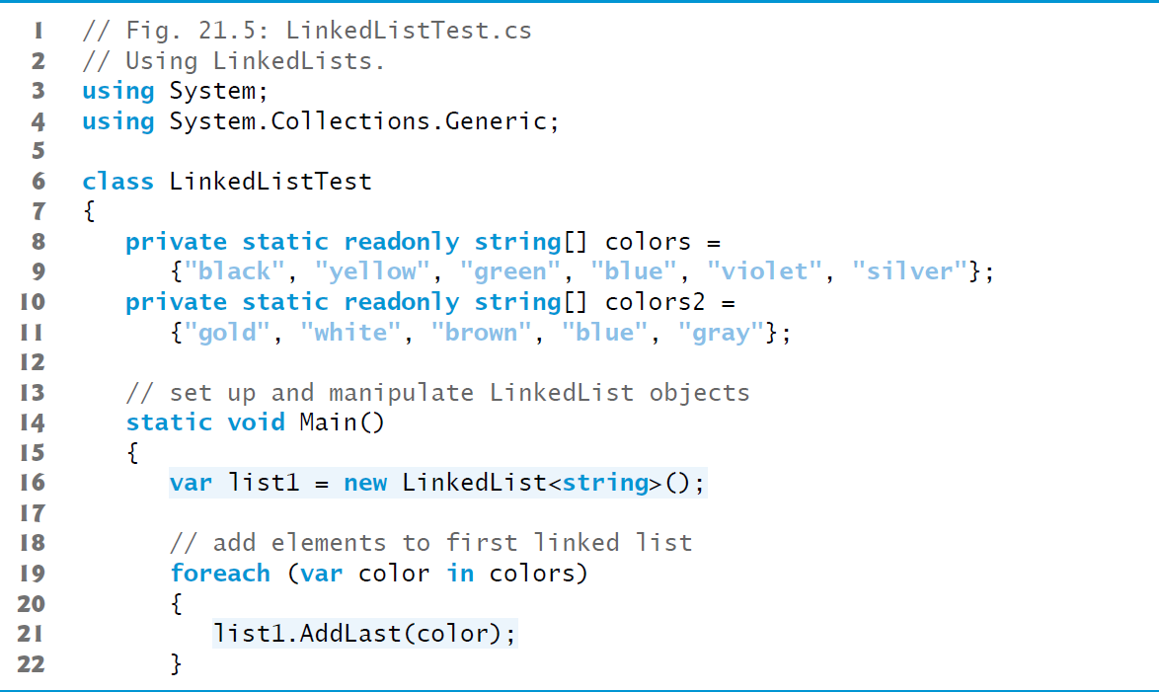
Figure 21.5 Using LinkedLists (1 of 8)

Slide 31
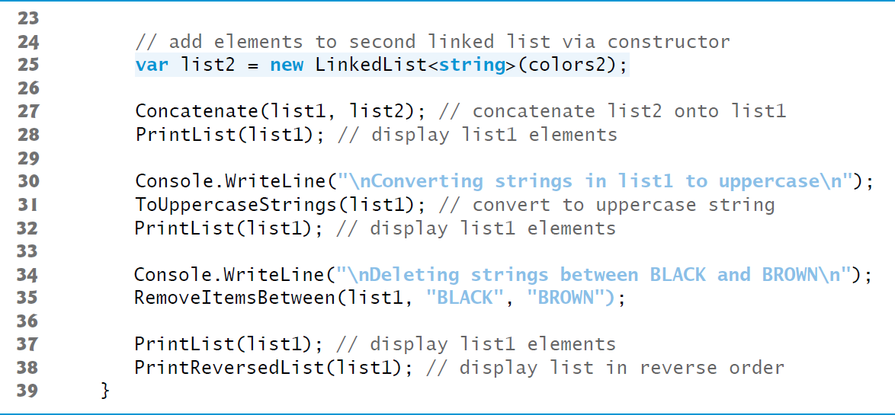
Figure 21.5 Using LinkedLists (2 of 8)

Slide 32
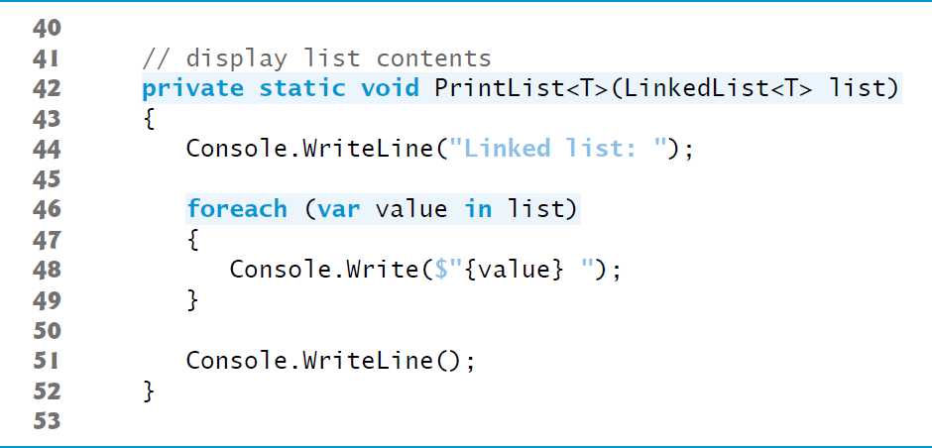
Figure 21.5 Using LinkedLists (3 of 8)

Slide 33
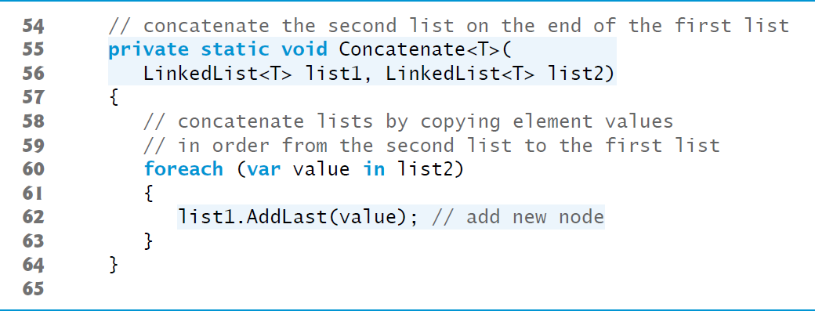
Figure 21.5 Using LinkedLists (4 of 8)

Slide 34
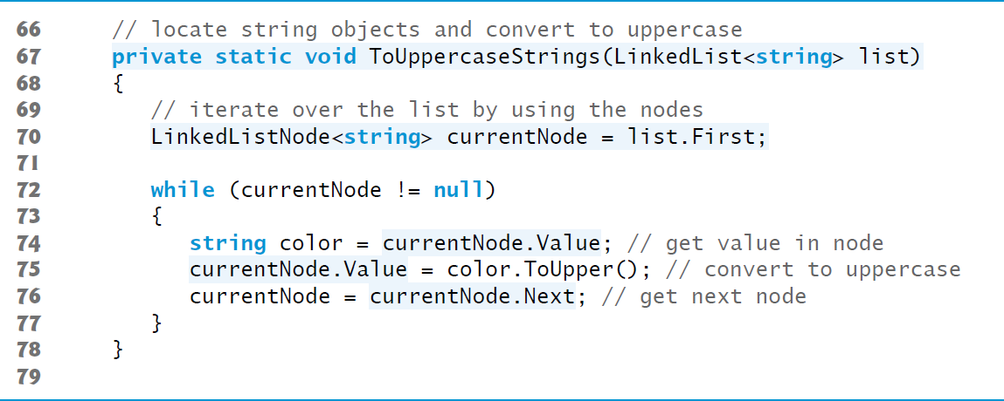
Figure 21.5 Using LinkedLists (5 of 8)

Slide 35
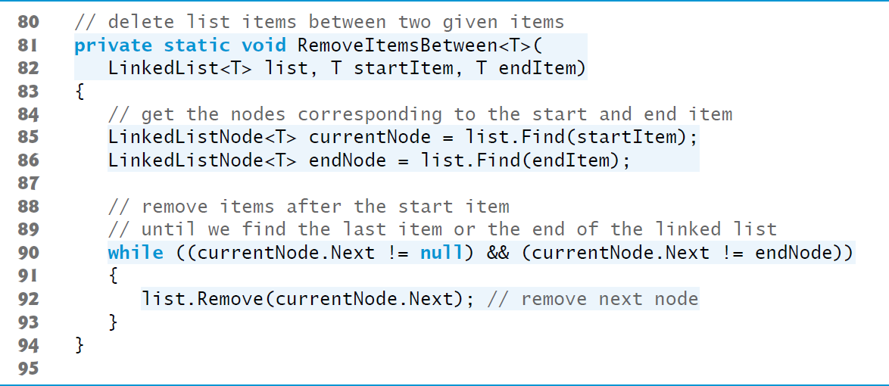
Figure 21.5 Using LinkedLists (6 of 8)

Slide 36
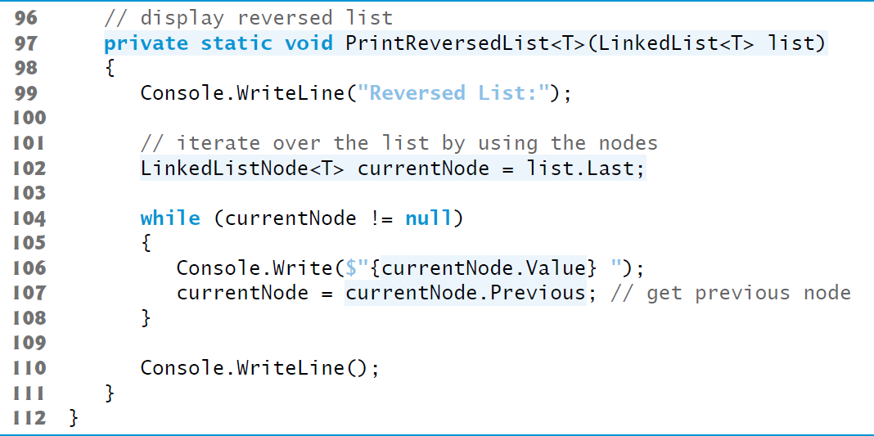
Figure 21.5 Using LinkedLists (7 of 8)

Slide 37
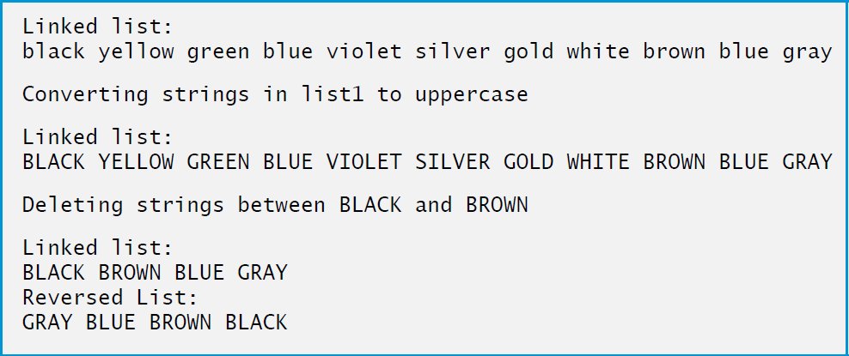
Figure 21.5 Using LinkedLists (8 of 8)

Slide 38
Software Engineering Observation 21.1
For maximal code reuse, define methods with generic type parameters whenever possible.

Slide 39
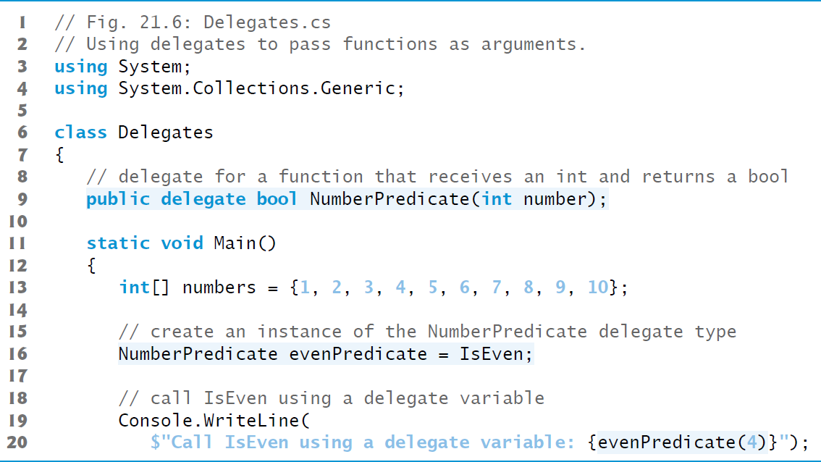
Figure 21.6 Using Delegates to Pass Functions as Arguments (1 of 5)

Slide 40
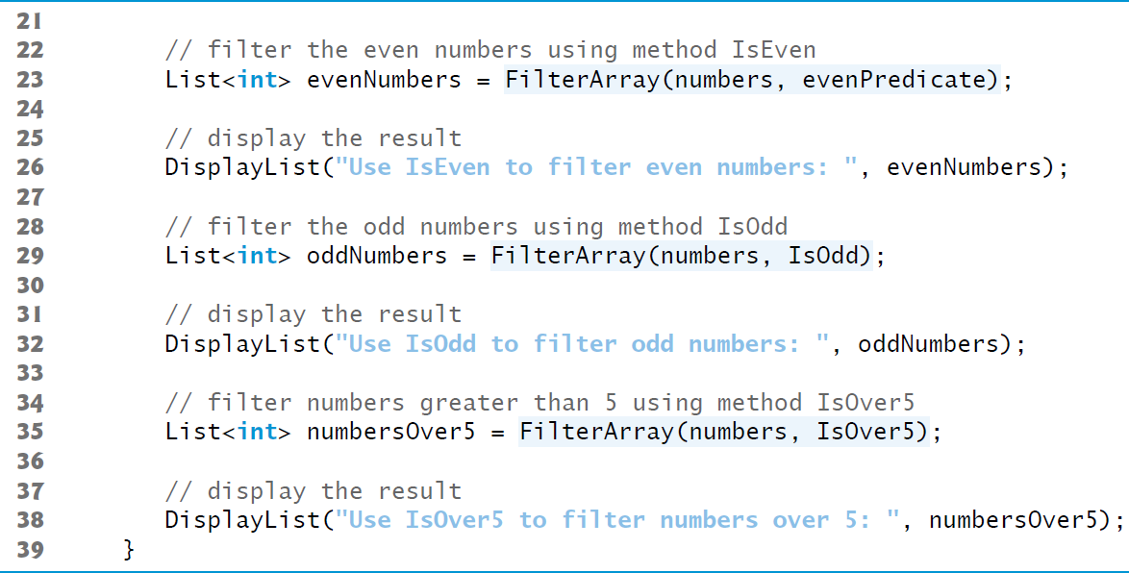
Figure 21.6 Using Delegates to Pass Functions as Arguments (2 of 5)

Slide 41
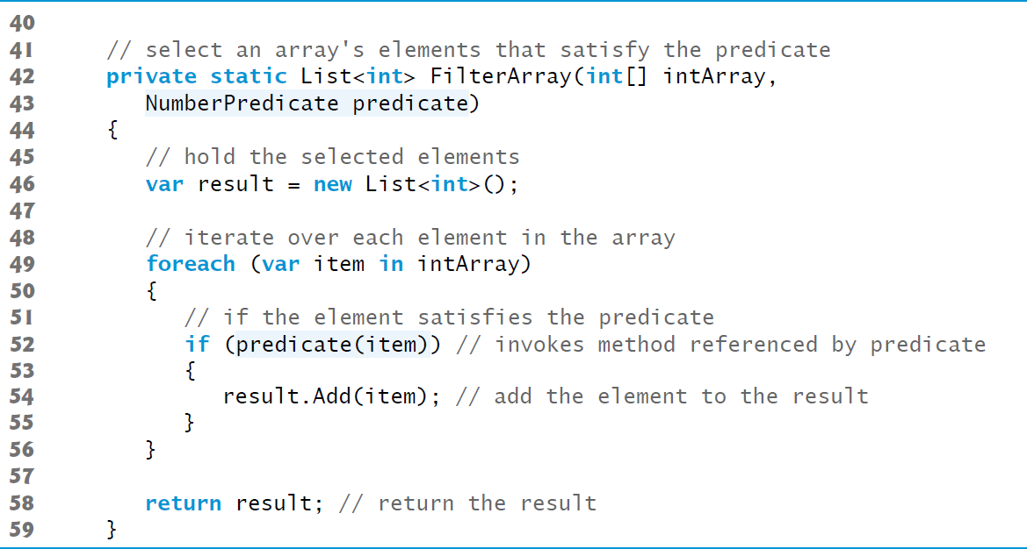
Figure 21.6 Using Delegates to Pass Functions as Arguments (3 of 5)

Slide 42
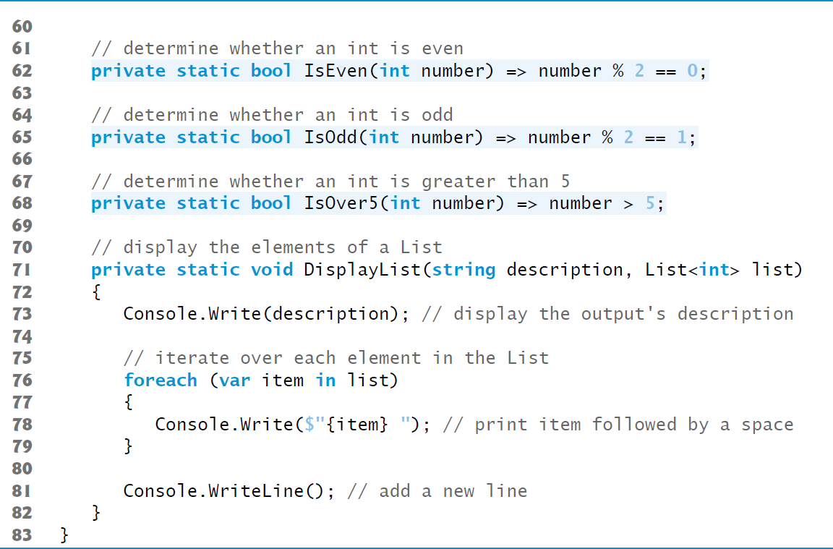
Figure 21.6 Using Delegates to Pass Functions as Arguments (4 of 5)

Slide 43
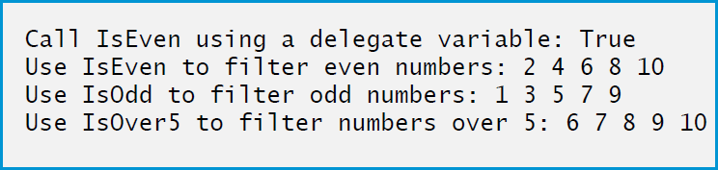
Figure 21.6 Using Delegates to Pass Functions as Arguments (5 of 5)

Slide 44
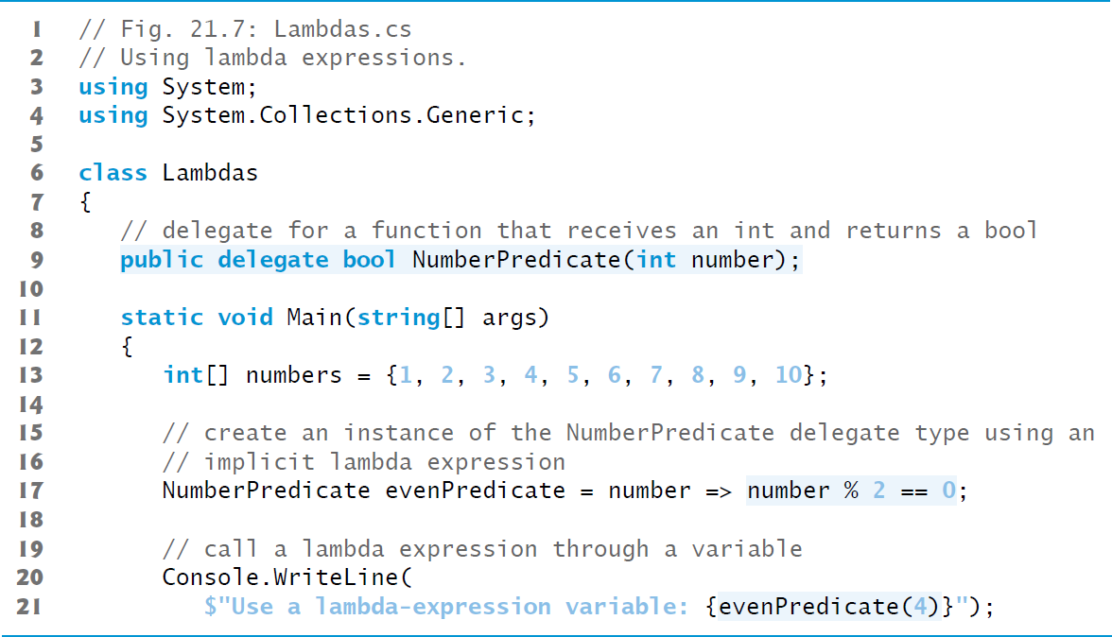
Figure 21.7 Using Lambda Expressions (1 of 5)

Slide 45
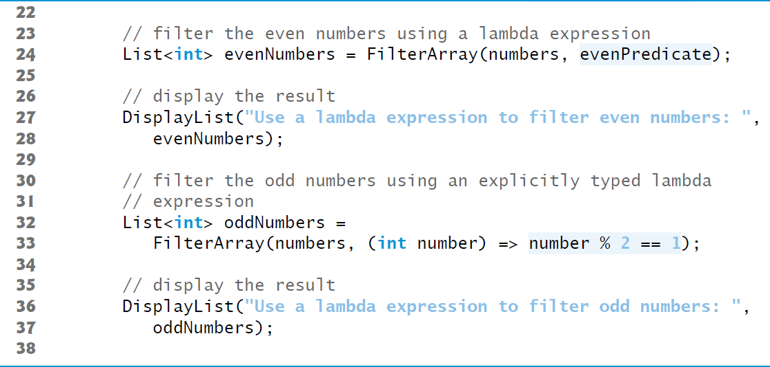
Figure 21.7 Using Lambda Expressions (2 of 5)

Slide 46
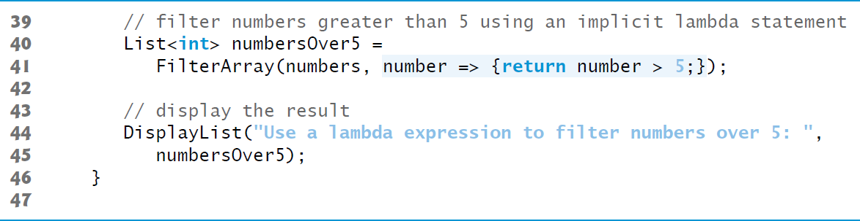
Figure 21.7 Using Lambda Expressions (3 of 5)

Slide 47
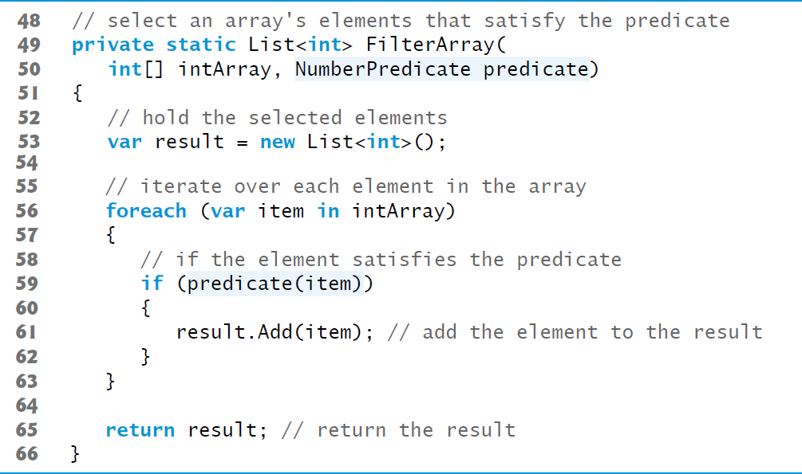
Figure 21.7 Using Lambda Expressions (4 of 5)

Slide 48
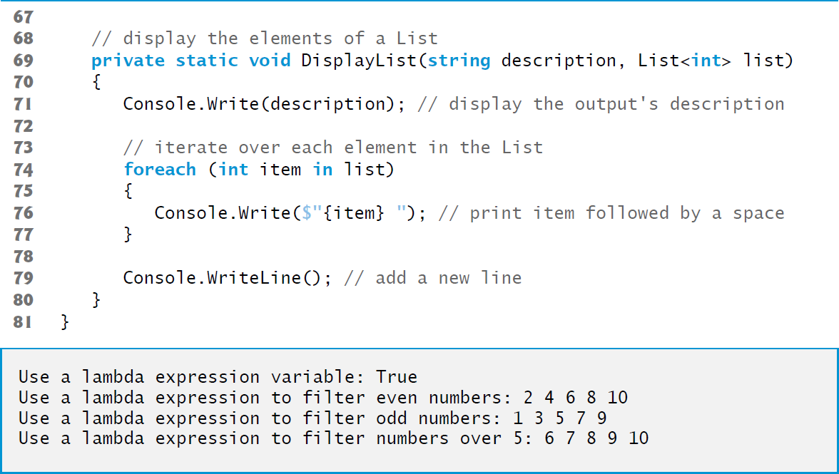
Figure 21.7 Using Lambda Expressions (5 of 5)

Slide 49
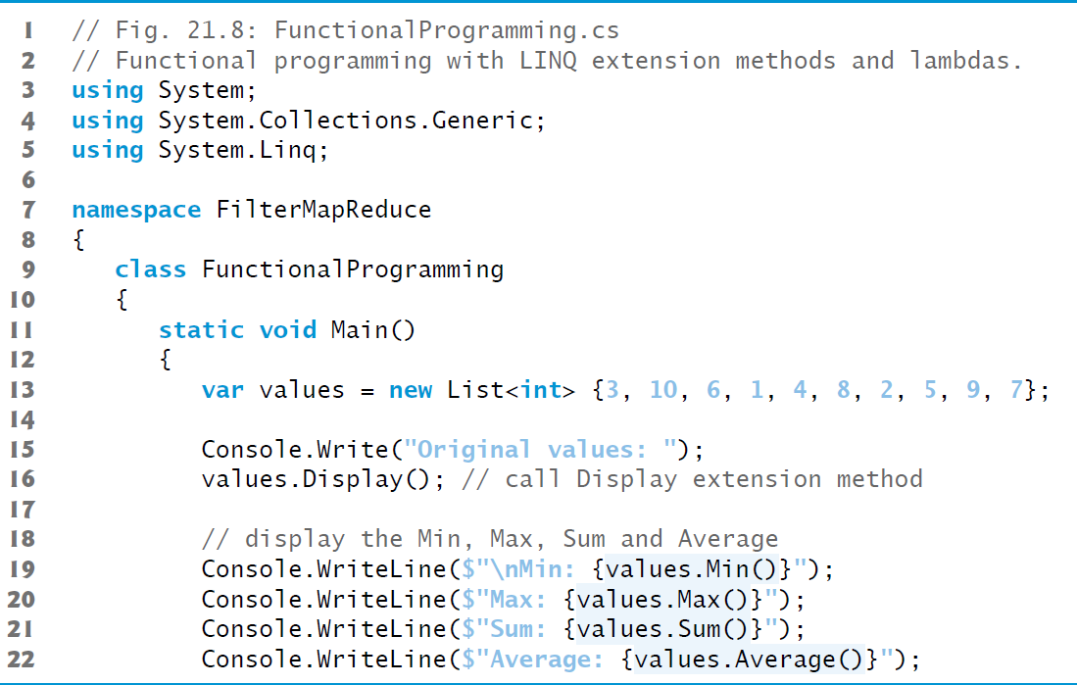
Figure 21.8 Functional Programming with L I N Q Extension Methods and Lambdas (1 of 4)

Slide 50
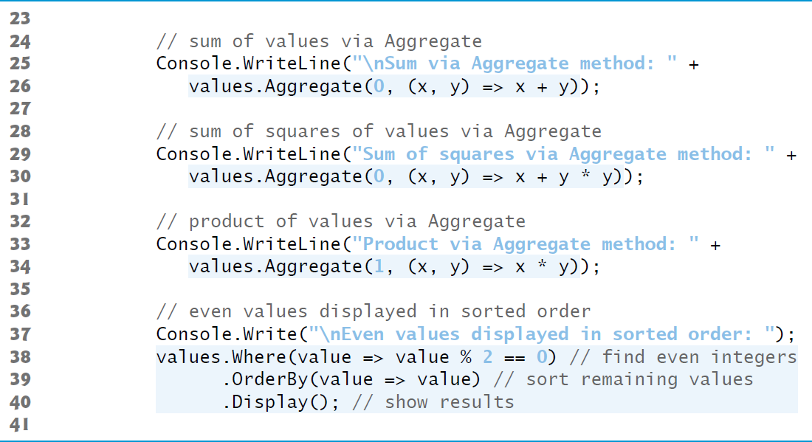
Figure 21.8 Functional Programming with L I N Q Extension Methods and Lambdas (2 of 4)

Slide 51
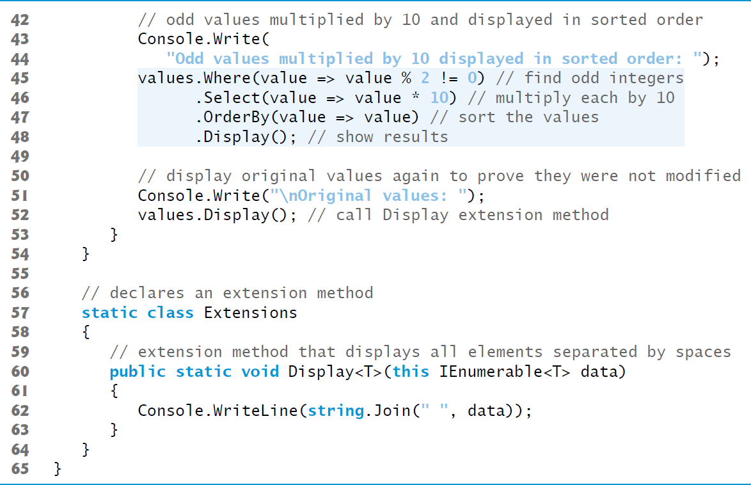
Figure 21.8 Functional Programming with L I N Q Extension Methods and Lambdas (3 of 4)

Slide 52
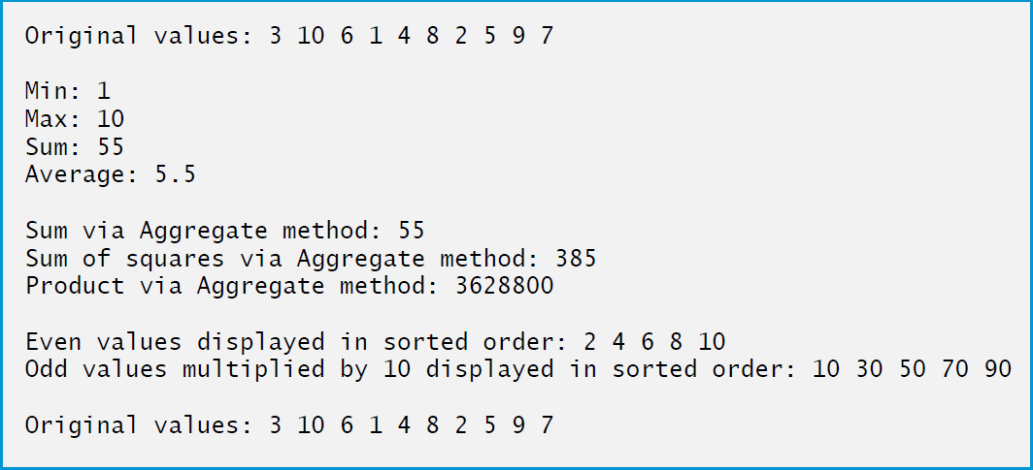
Figure 21.8 Functional Programming with L I N Q Extension Methods and Lambdas (4 of 4)

Slide 53
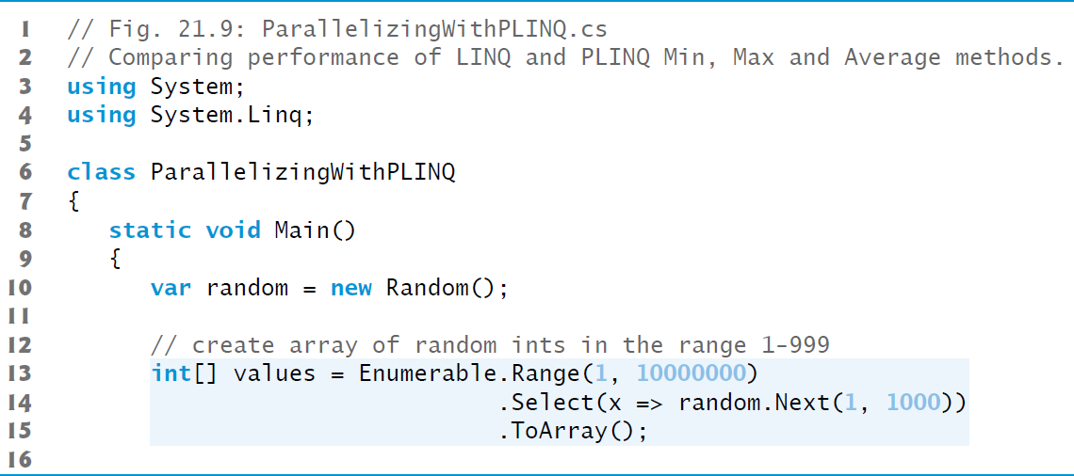
Figure 21.9 Comparing Performance of L I N Q and P L I N Q Min, Max and Average Methods (1 of 6)

Slide 54
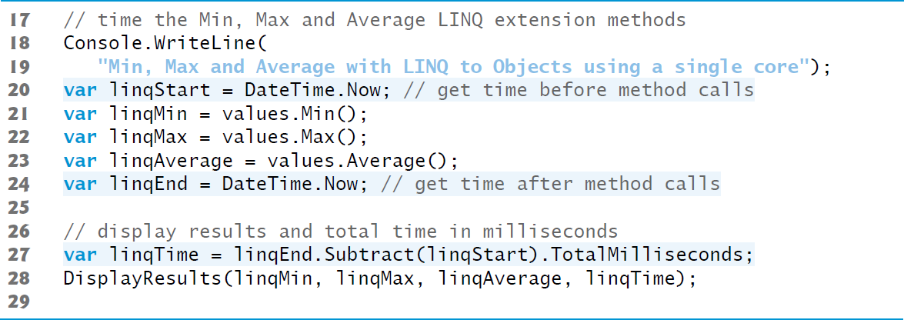
Figure 21.9 Comparing Performance of L I N Q and P L I N Q Min, Max and Average Methods (2 of 6)

Slide 55
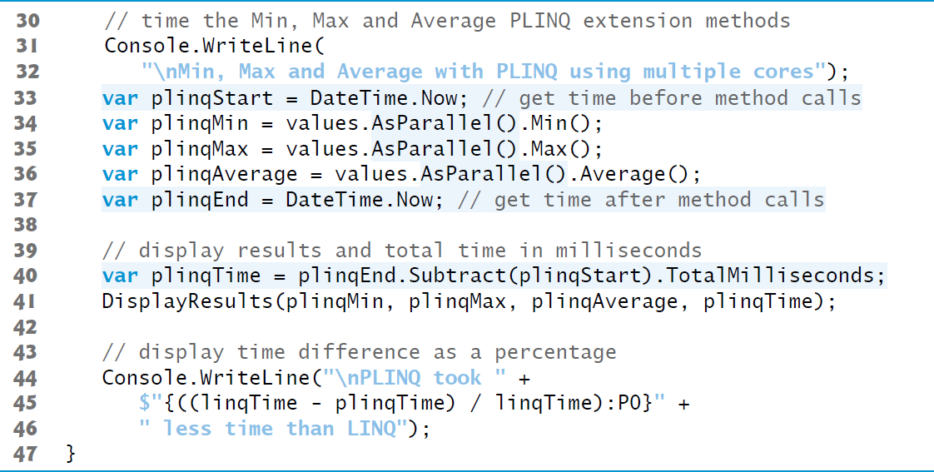
Figure 21.9 Comparing Performance of L I N Q and P L I N Q Min, Max and Average Methods (3 of 6)

Slide 56
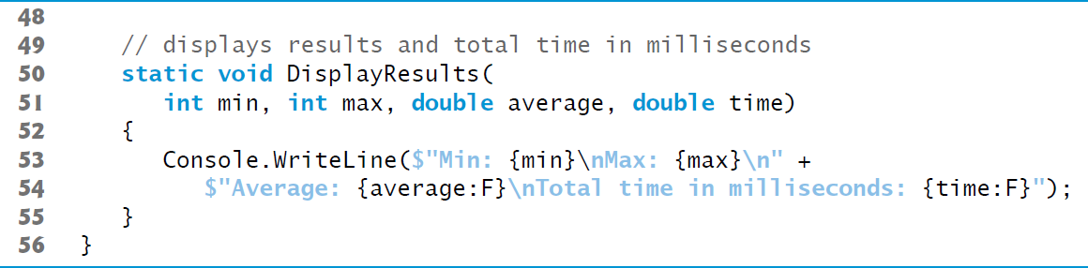
Figure 21.9 Comparing Performance of L I N Q and P L I N Q Min, Max and Average Methods (4 of 6)

Slide 57
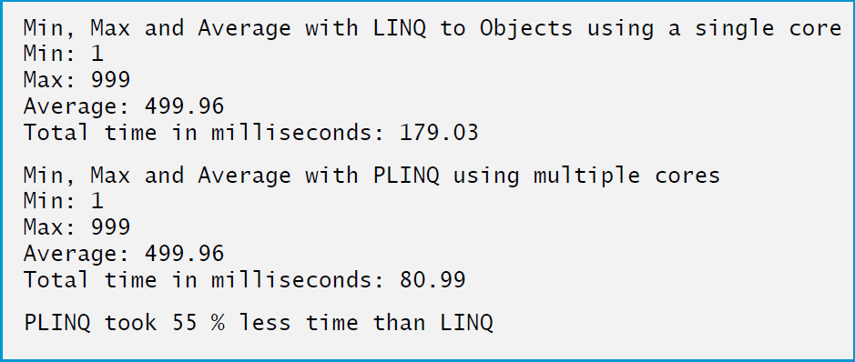
Figure 21.9 Comparing Performance of L I N Q and P L I N Q Min, Max and Average Methods (5 of 6)

Slide 58
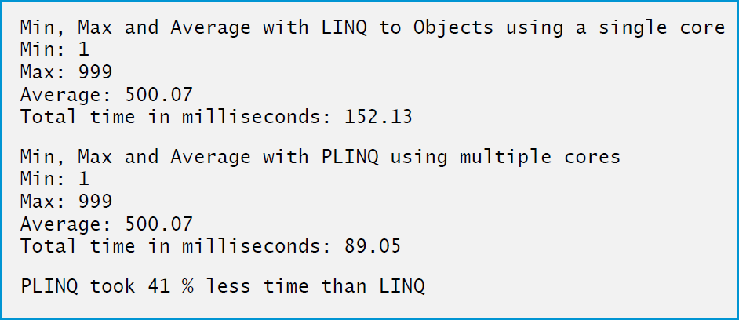
Figure 21.9 Comparing Performance of L I N Q and P L I N Q Min, Max and Average Methods (6 of 6)

Slide 59

Copyright

